Slide 1

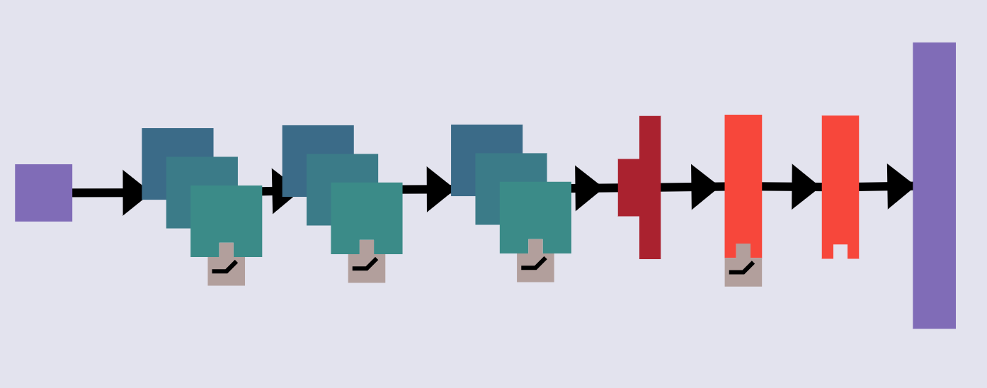
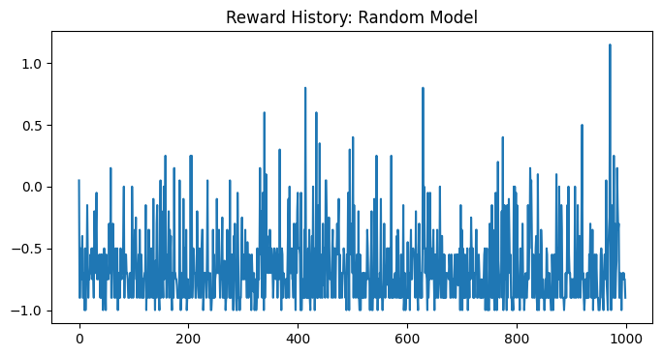
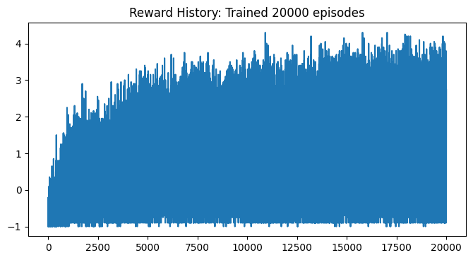
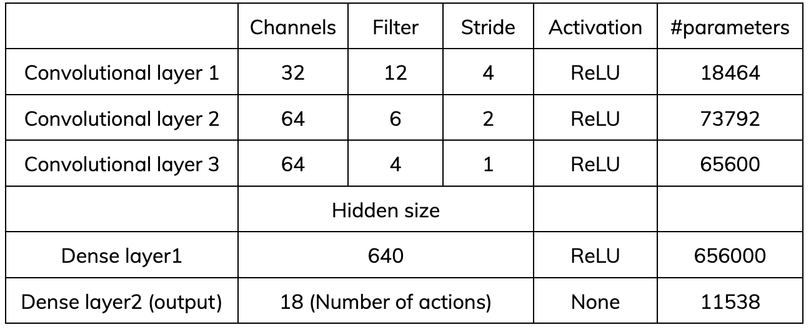
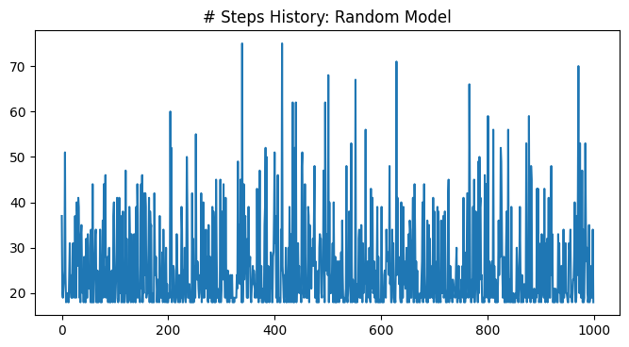
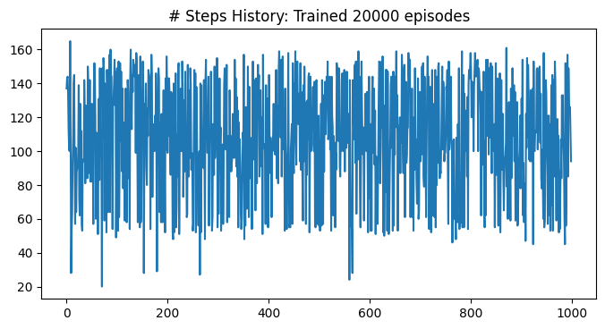
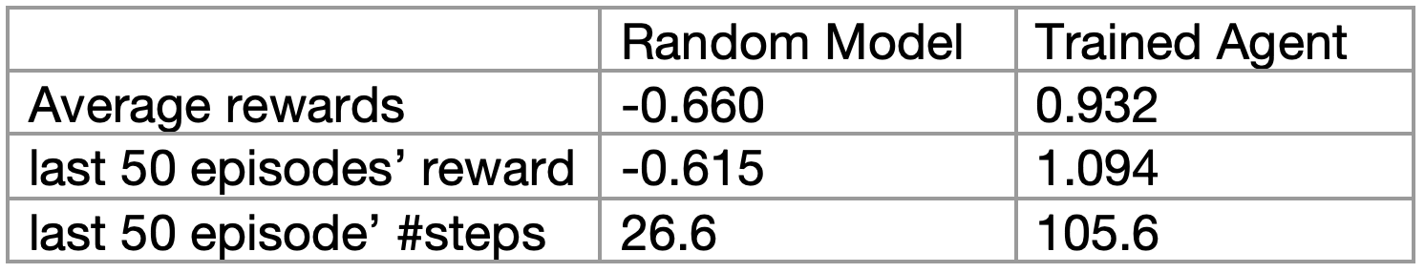
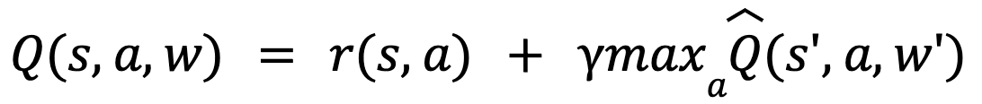
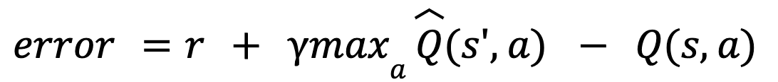
Deep Q-Learning for Atari River Raid
Yash Mehta, Yuetian Li, Yingfei Hong, Nange Li
Introduction
Model Architecture
Results
We implemented Deep Q-Learning Networks (DQN) to play Atari 2000 River Raid with two strategies: fixed Q-targets and replay memory mechanism to handle the oscillation in training due to shifting Q target values and ensure efficient training. We also introduced custom reward function. Our goal is to train the agent to perform ‘much’ better than the random model.
Random Model
Trained Agent
Methodology
1. Preprocessing: converted RGB game frames to grayscale, resized the frame to 84×84 pixels; apply k-skipping by concatenating k=4 consecutive frames for the model to predict one action, and repeat this action k times to get four observations
2. Custom modifications in reward functions: We added a large negative death reward to train agent to avoid death. Rescaled and normalized the rewards so gradient calculations were more consistent and allowed stable training.
3. Fixed Q target value at every time step allows for stable learning:
where s is the current state, s’ is the next state after taking the action a, r is the reward for taking the action a, 𝛾 represents the discounted factor, Q is the Q network, Q hat is the target network and every T steps: w’ = w.
4. Replay Memory mechanism uses past experiences to update the Q network in addition to the update in each time step. Given a fixed number of past experiences, we will randomly sample a small batch of experiences from the buffer. For each experience, the error will be:
Discussion and Outlook
Overall, the current project is successful in training the agent to learn control policies based on high-dimensional sensory input through DQN and the agent outperforms the random state greatly.
Future directions:
1. The agent failed to distinguish the fuel depots from enemies, but shoot all to receive points. To improve, we can extract information representing the power bar and add a term to the reward function.
2. Tune k value in k-skipping method. A larger k provides the model with more information to predict an action, but as the action is repeated k times, it might not be the optimal strategy.
3. Try dual DQN to reduce the instability of training.

